Slide 1



About us
Team Name:-coder's
Introducing the innovative team behind a crucial healthcare solution.
Team Leader
Harshit Jain
Team Members
Divyanshu Sankhla
Jatin Panchal
Hemraj Vaishnav
Problem Statement
Optimize hospital operations, including bed allocation
and resource management, using AI-driven solutions.
Problem id
ICIH-11
Theme
Dedicated to enhancing Health and Well-being through
technological innovation.

Slide 2

Introduction
What is a Hospital Management System?
A Hospital Management System (HMS) is a comprehensive digital platform that unifies all hospital operations. It automates patient information, medical records, appointments, billing, and administrative tasks.

Slide 3



Project Objectives
Enhanced Patient Care
Efficient Record Management
Process Automation
Streamline patient management processes to ensure faster, more accurate medical services and improved patient satisfaction.
Automate routine administrative tasks including appointment scheduling, billing, and report generation to reduce manual errors.
Centralise all medical records, patient history, and treatment data in a secure, easily accessible digital format.

Slide 4

Existing Problems in Traditional Systems
Paper-Based Record Keeping
Manual filing systems lead to lost records, damaged documents, and difficulty in retrieving patient information during emergencies.
Long Waiting Times
Inefficient appointment scheduling and patient registration processes result in extended waiting periods and patient dissatisfaction.
Human Errors
Manual data entry increases the risk of medication errors, billing mistakes, and miscommunication between departments.
Resource Wastage
Duplicate tests, overstocking of medicines, and inefficient resource allocation due to lack of integrated information systems.

Slide 5
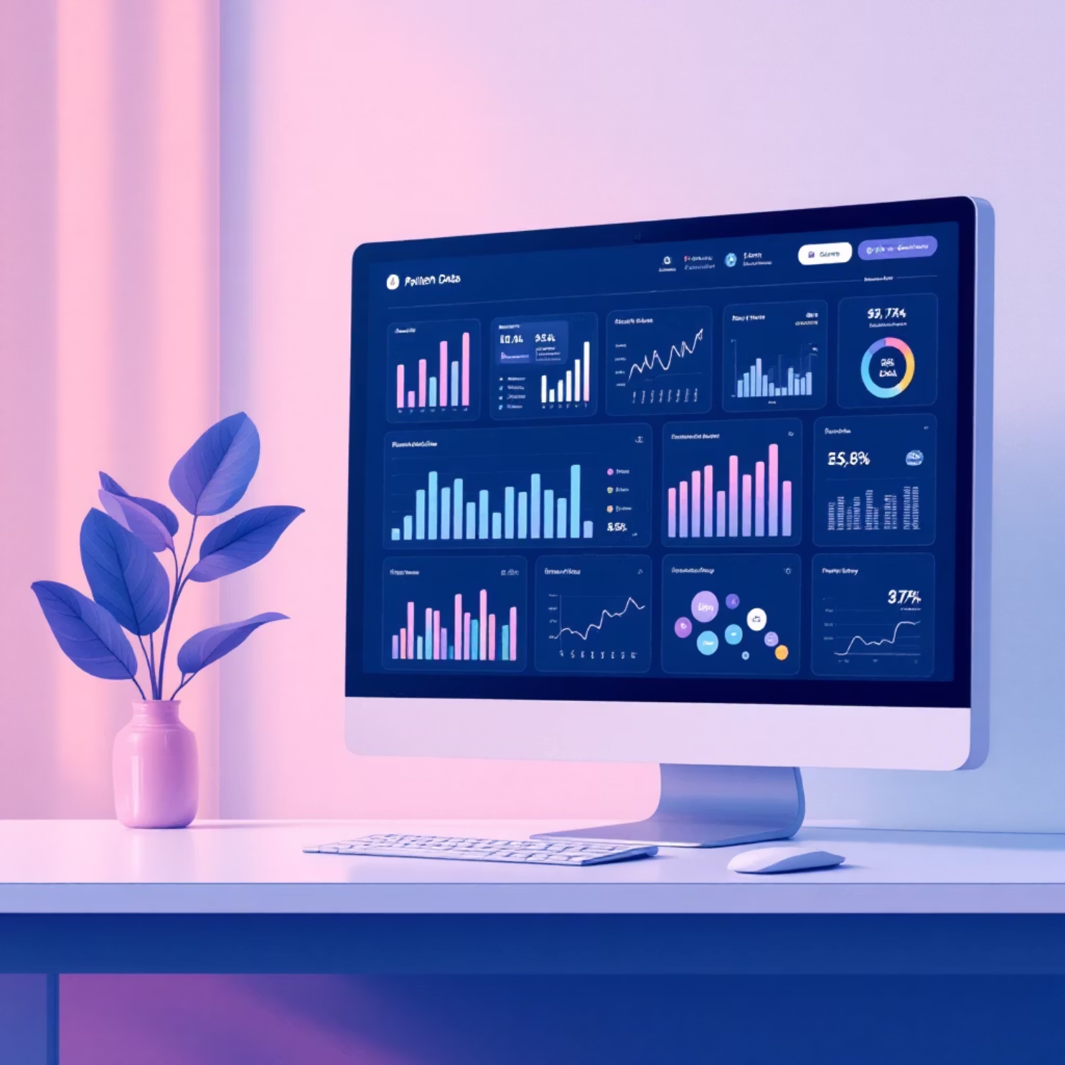
Proposed Solution
Integrated Digital Platform
Our Hospital Management System provides a complete digital transformation solution that addresses all traditional healthcare management challenges through:
Real-time data synchronisation across departments
Automated workflow management
Secure cloud-based storage
Integration with medical equipment and laboratory systems

Slide 6






Core System Features
Patient Registration
Appointment Scheduling
Comprehensive patient enrollment with personal details, medical history, insurance information, and emergency contacts stored securely.
Online booking system with automated reminders, doctor availability tracking, and flexible rescheduling options for patients.
Doctor Management
Billing System
Complete physician profiles including specialisations, schedules, patient assignments, and performance analytics.
Automated invoice generation, insurance claim processing, payment tracking, and financial reporting with audit trails.
Laboratory Integration
Analytics & Reports
Seamless connection with diagnostic equipment for instant test results and automated report distribution to concerned doctors.
Comprehensive reporting dashboard with patient statistics, financial analysis, and operational performance metrics for management decisions.

Slide 7

System Modules
Administrator Module
Complete system control including user management, security settings, data backup, system configuration, and comprehensive reporting capabilities.
Doctor Module
Patient consultation interface, medical record access, prescription management, appointment viewing, and treatment history tracking.
Receptionist Module
Patient registration, appointment booking, visitor management, billing assistance, and front-desk operational support.
Patient Portal
Online access to medical records, appointment booking, test results, billing information, and communication with healthcare providers.

Slide 8
Technology Stack
Development Technologies
Infrastructure & Database
Frontend
Database
HTML5 & CSS3
MySQL/PostgreSQL
JavaScript
Data Encryption
Backup Systems
Backend
Deployment
Node.js & Express.js
Cloud Hosting (AWS/Azure)
RESTful APIs
Load Balancing
Authentication Systems
SSL Security

Slide 9



Key Advantages
75%
90%
100%
Time Savings
Accuracy Improvement
Paperless Operations
Reduction in administrative processing time through automated workflows and digital record management.
Decrease in data entry errors and medication mistakes through automated validation and cross-verification systems.
Complete elimination of paper-based processes, contributing to environmental sustainability and cost reduction.
Additional benefits include improved patient satisfaction, enhanced data security, better resource utilisation, and compliance with healthcare regulations and standards.

Slide 10

Conclusion & Future Scope
Project Summary
The Hospital Management System successfully addresses critical challenges in healthcare administration through comprehensive digital transformation. Our solution provides integrated patient care management, streamlined operations, and improved healthcare delivery.
Future Enhancements
AI-powered diagnostic assistance and predictive analytics
IoT integration for real-time patient monitoring
Telemedicine capabilities for remote consultations
Mobile application for enhanced patient engagement
Integration with national health databases
"Transforming healthcare through technology, one patient at a time."

